Slide 1

SECTION 2 – What is a Program?
PYTHON BASICS – LEARN PYTHON PROGRAMMING
FOR BEGINNERS

Slide 2
SECTION 2 – WHAT IS A PROGRAM?
2.1 Definition
A program is a set of instructions that tells a computer
what to do and how to do it.
All of your interactions with computer are controlled
by a program behind the scenes
PYTHON BASICS – LEARN PYTHON PROGRAMMING
FOR BEGINNERS

Slide 3
SECTION 2 – WHAT IS A PROGRAM?
2.2 How a Program Works?
Computer can perform only one task at the time
A program involves many simple steps
to solve a complex program
PYTHON BASICS – LEARN PYTHON PROGRAMMING
FOR BEGINNERS

Slide 4
SECTION 2 – WHAT IS A PROGRAM?
2.3 Building Blocks
Input – What the program receives
(like a mouse click or a number).
Processing – What the program does with that information.
Output – What the program gives back
(a result, image, sound, or action).
PYTHON BASICS – LEARN PYTHON PROGRAMMING
FOR BEGINNERS

Slide 5
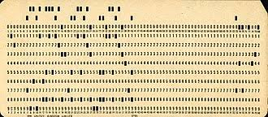
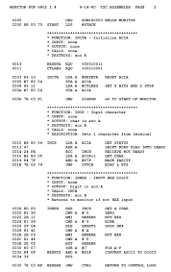
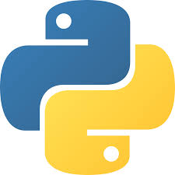

SECTION 2 – WHAT IS A PROGRAM?
2.4 a Little History
First programs were created with punch cards
To change the program you had to manually change the cards
Now the modern languages allow to program
without touching the hardware
PYTHON BASICS – LEARN PYTHON PROGRAMMING
FOR BEGINNERS

Slide 6
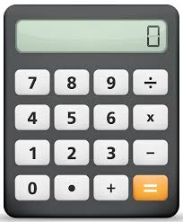
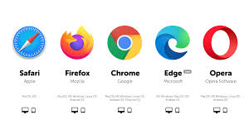
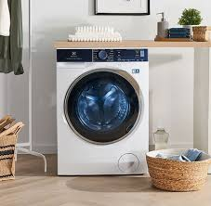
SECTION 2 – WHAT IS A PROGRAM?
2.5 Everyday Examples of Programs
PYTHON BASICS – LEARN PYTHON PROGRAMMING
FOR BEGINNERS

Slide 7
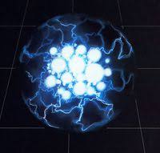
SECTION 2 – WHAT IS A PROGRAM?
2.6. Why Programming Matters?
PYTHON BASICS – LEARN PYTHON PROGRAMMING
FOR BEGINNERS

Slide 8
SECTION 2 – WHAT IS A PROGRAM?
2.7 Final Thoughts
PYTHON BASICS – LEARN PYTHON PROGRAMMING
FOR BEGINNERS

